Slide 1




Mental Health Survey
CSC 465: Data Visualization
Team 3
Anika
Deepak
Jaymin
Kripa

Slide 2
Introduction

Slide 3
Introduction
According to the National Alliance on Mental Illness (NAMI), a mental illness is a condition that affects a person’s thinking, feeling, or mood
One in 5 adults experience a mental health condition every year
There are many different types of mental health conditions and the severity of these conditions differs among each individual

Slide 4
Data

Slide 5
Data
Researchers surveyed 1260 employees at tech companies about their history and opinions on mental health
The data had around 27 fields of mostly Yes/No/Maybe responses
Some notable data fields that helped form our story were: benefits, treatment, coworkers, supervisor, family_history, gender

Slide 6
Visualizations

Slide 7
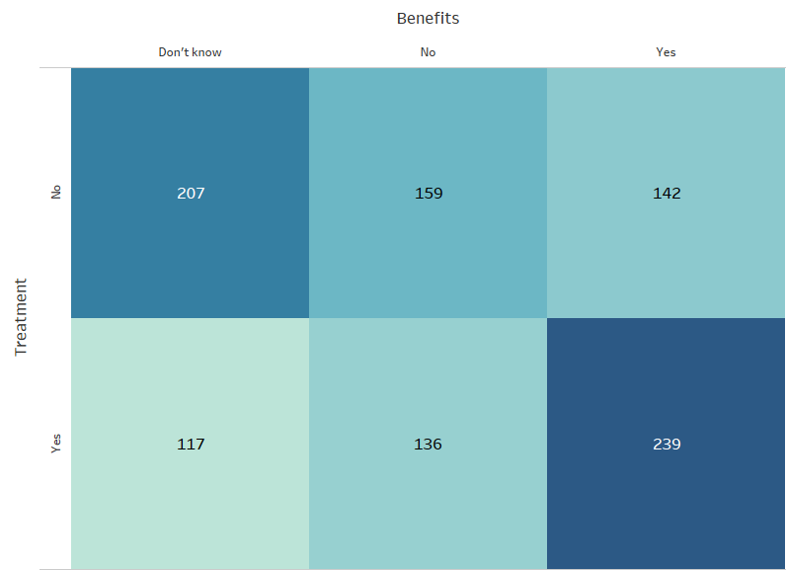
Benefits
Whether respondents requiring treatment have benefits
Large number of respondents who required treatment did not have benefits
Large number of respondents who required treatment did not know if they had benefits

Slide 8
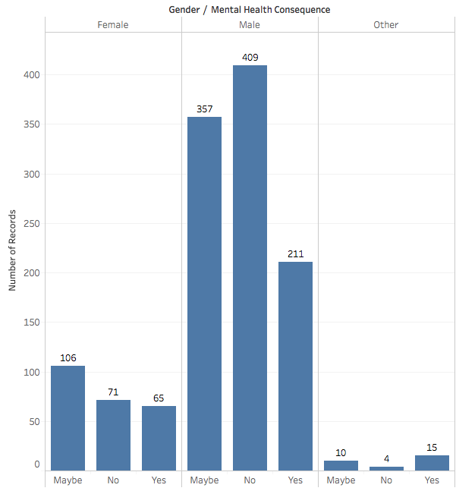
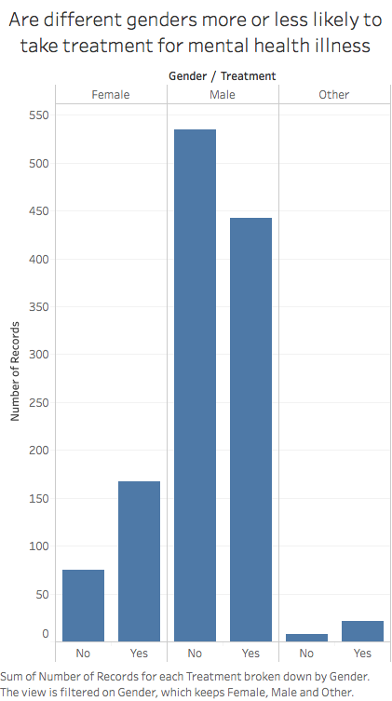
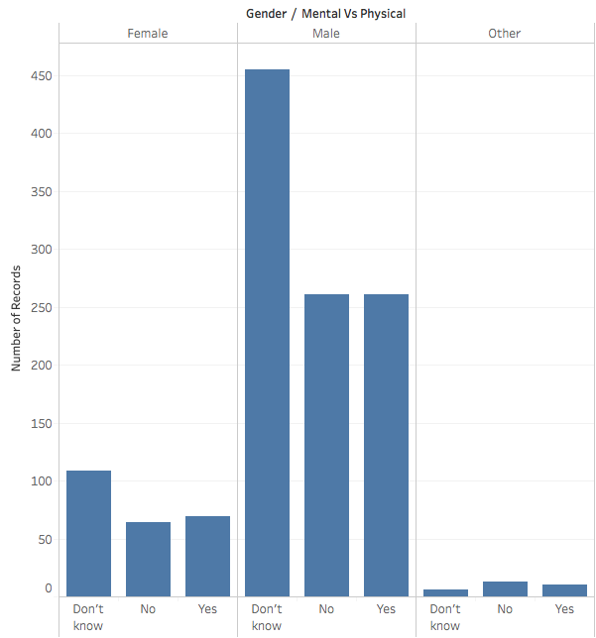
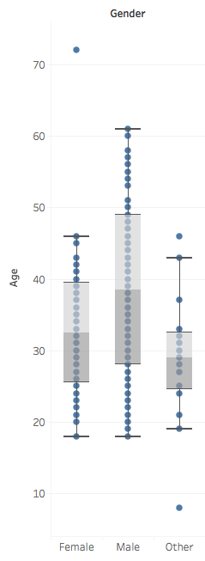
Gender
How gender played a role in participant responses towards mental issues and treatment
Females are more likely to take treatment than males
Respondents who identified themselves as ‘Other’ faced higher negative mental health consequences

Slide 9
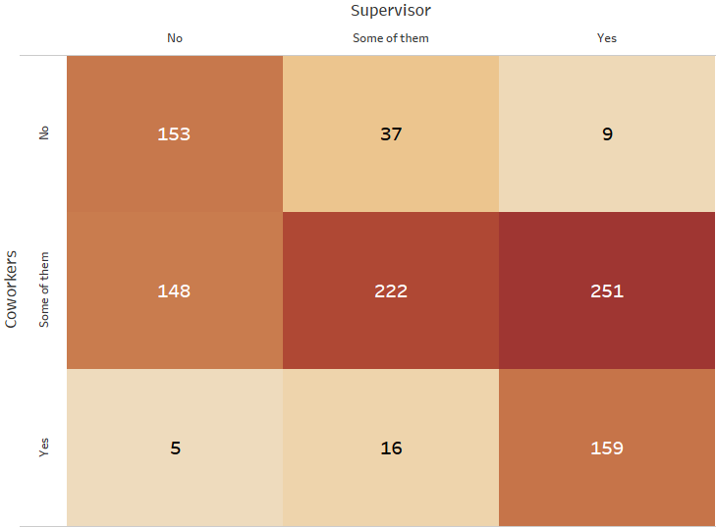
Workplace
Whether respondents felt comfortable discussing mental health issues with coworkers / supervisors
Majority of respondents felt comfortable discussing with their supervisors, and with some of their coworkers
Respondents were more likely to share with both supervisor and coworkers, rather than just one or the other, or not share at all.

Slide 10
Family History
Whether there was any correlation between family history and treatment
Family history and treatment have positive correlation
California, Texas and Tennessee were among the states with highest reported family history and treatment

Slide 11
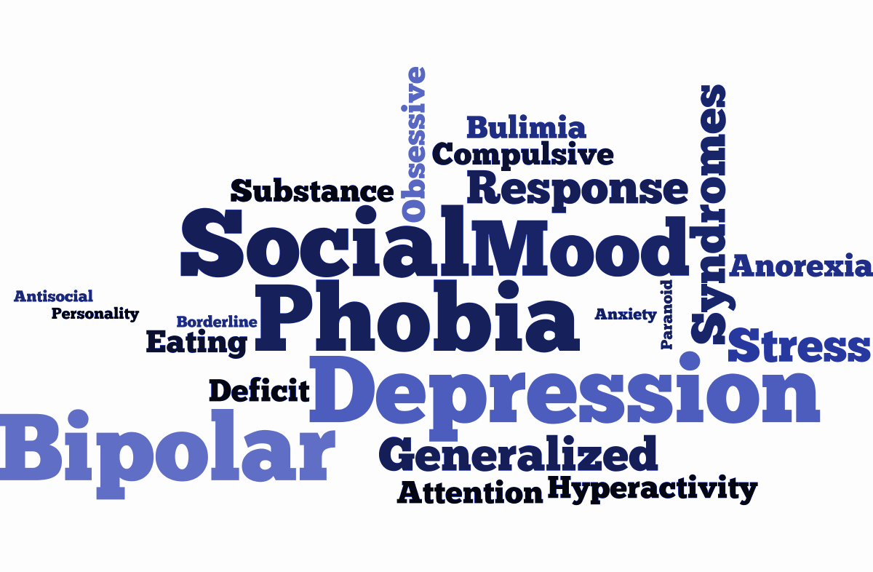
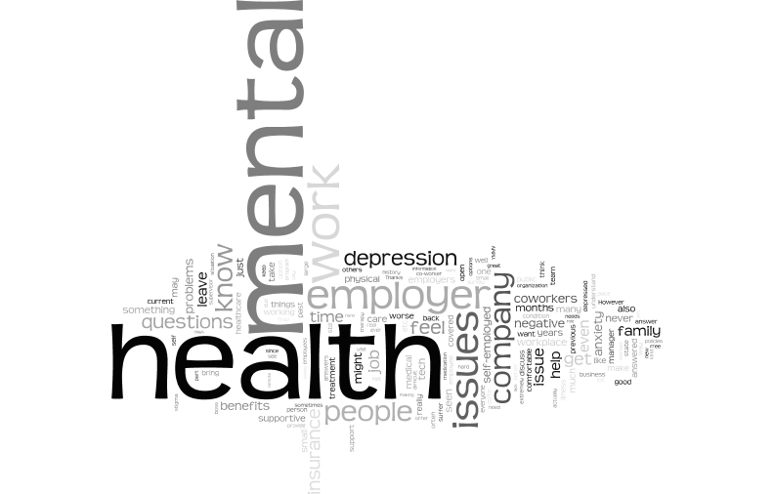
Exploratory Visualizations
Mental Health Disorders
Respondent Comments

Slide 12
Suggestions
Employer Awareness
Employee Benefits
Work Environment
- Improve awareness of issues that exacerbate employees’ mental health
- Pro-active measures to ensure employees’ best health interests
- Employees need to keep abreast of their employer health benefits
- Remote work opportunities for employees with mental health issues
- A transparent work environment where discussion is encouraged
- Improve gender equality and attend to requirements of employees who identify as other genders

Slide 13
Thank you!
Team 3
Anika
Deepak
Jaymin
Kripa

